Slide 1
Test of Hotelling’s Law at Manhattan
By Shu Yoko

Slide 2
Test about the Hotelling’s Law If it actually works in real business environment
Hotelling Law is that: ”Suppose there are two competing shops located along the length of a street running north and south, with customers spread equally along the street. Both shop owners want their shops to be where they will get most market share of customers. If both shops sell the same range of goods at the same prices then the locations of the shops are themselves the 'products'. Each customer will always choose the nearer shop as it is disadvantageous to travel to the farther.” - Wikipedia

Slide 3
Hotteling’s Law
Basically, this theory argues that if the shops offer the similar products, the shop with most dominant area will win. Here is some figure that explain. Let's say there are two stores A and B. If they decided to open their shop in a linear city that has 12 dashes of land.
|------|------|

Slide 4
Hotteling’s Law
First, they build the shop as they can share same amount of customer. They both win ------ (6 dashes) of the area/customers that are coming from.
|---A---|---B---|

Slide 5
Hotteling’s Law
But if B moves 2 dashes closer to shop A.
Shop B wins some of A's customers since they sell similar products and customer choose to go to the closer shop. A loses some of its customers.
|---A---|-B-----|

Slide 6
Hotteling’s Law
So A decided to move towards shop B, so A can win some customers too.
Here, both shops end up with locating at the center.
|------A|B------|

Slide 7
Hotteling’s Law
Likewise, this theory argues that if the shop was located away from the center, they will loose the competition.
|------A|----B--|

Slide 8
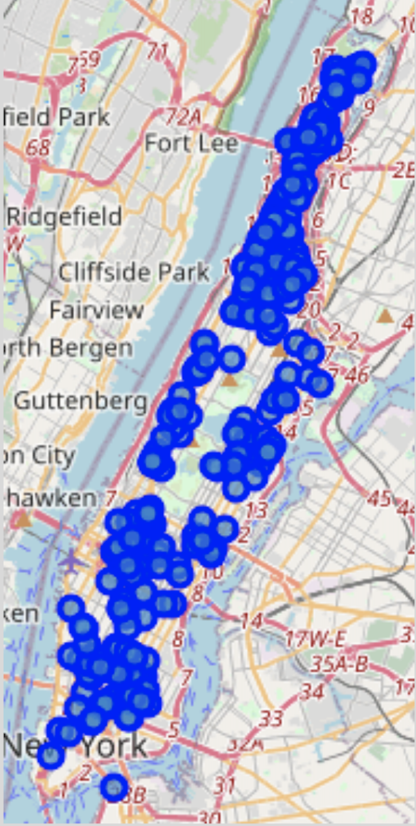
Hotteling’s Law
In this project, I will test if this theory works at the city in Manhattan
|------A|----B--|
True?

Slide 9
Data acquisition and cleaning
I will use Foursquare data in Manhattan. For all pizza restaurants in Manhattan with similar rate (6-8 range out of 10), I will see if the pizza restaurants in the near the center of Manhattan has more likes (to estimate # of customers).
Location Data of shops: Forsquare API
Shop Ratings: Forsuare API

Slide 10


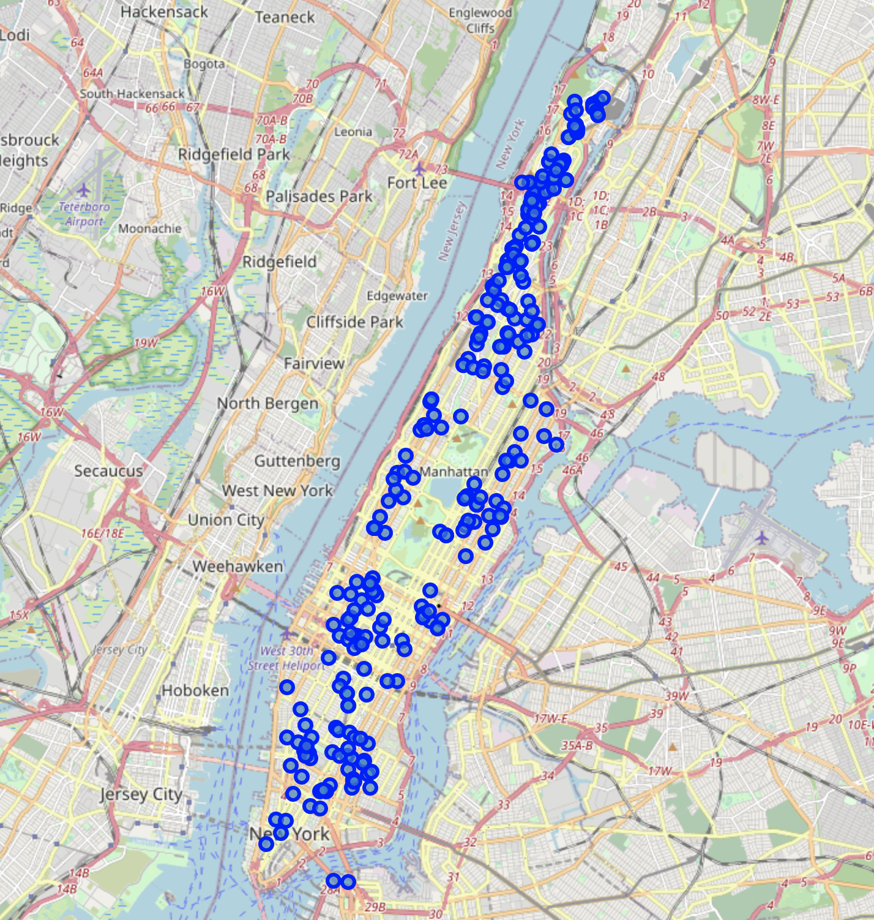

Pizza Restaurant in Manhattan (n = 265)
z

Slide 11
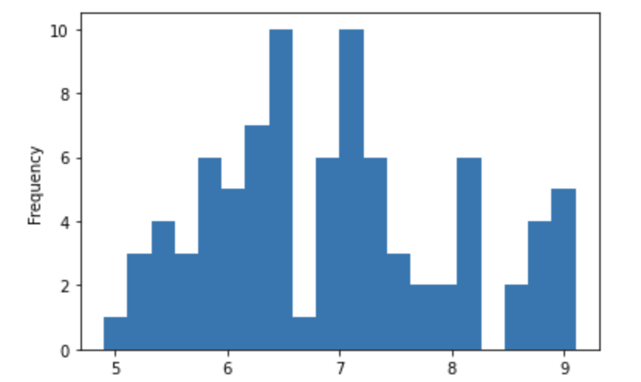
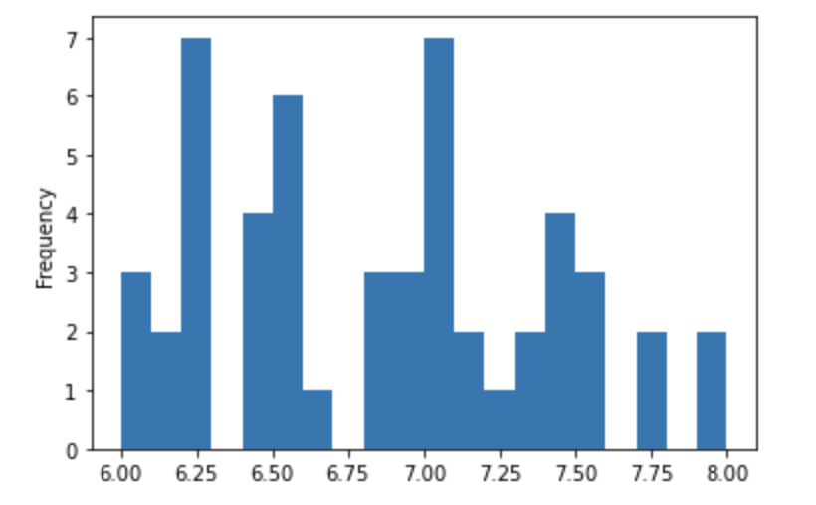
Sample Stats
Mean Rating: 6.92
Rating Distribution (Out of 10)
Rating Distribution (Range to 6 to 8)

Slide 12
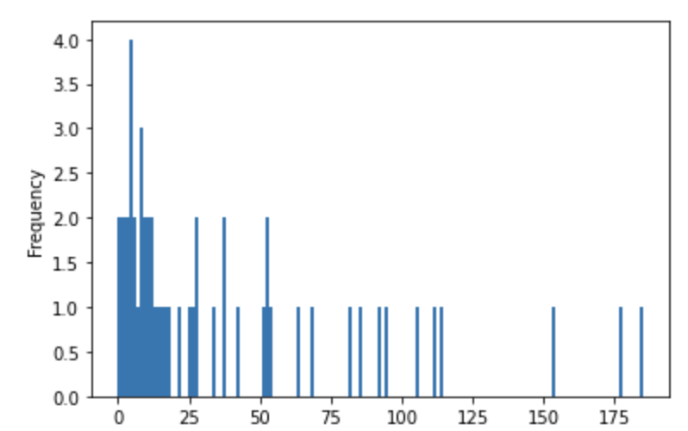
Sample Stats -2
Mean Rating: 30.6
# of Likes Distribution

Slide 13
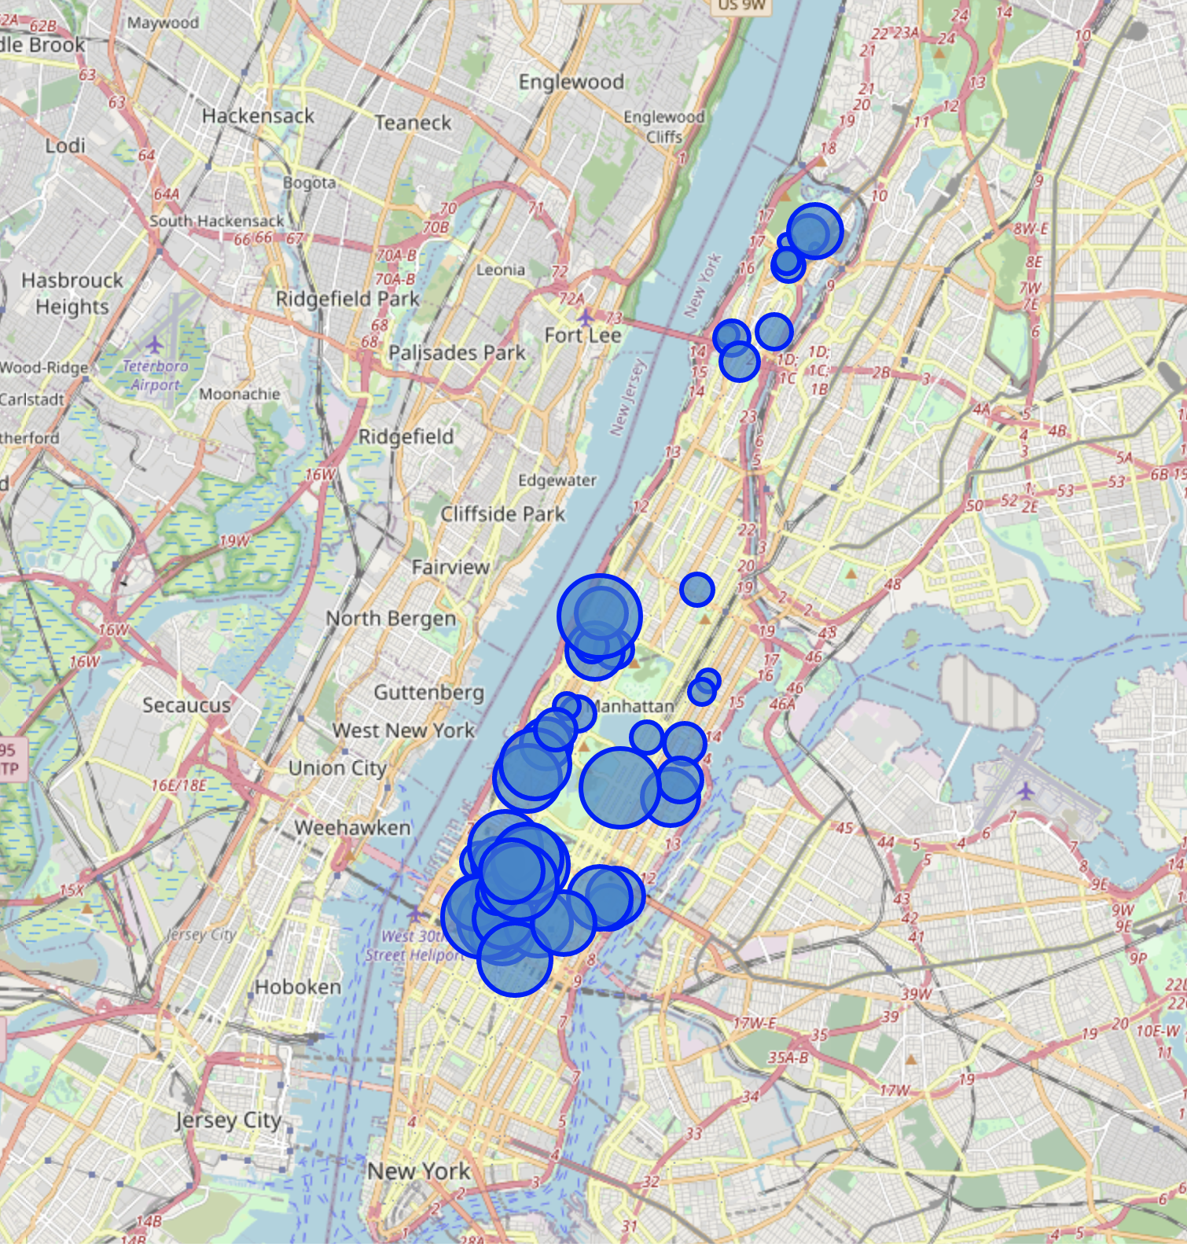
Pizza Restaurant in Manhattan With Ratings between 6 to 8 (n = 52)
z

Slide 14
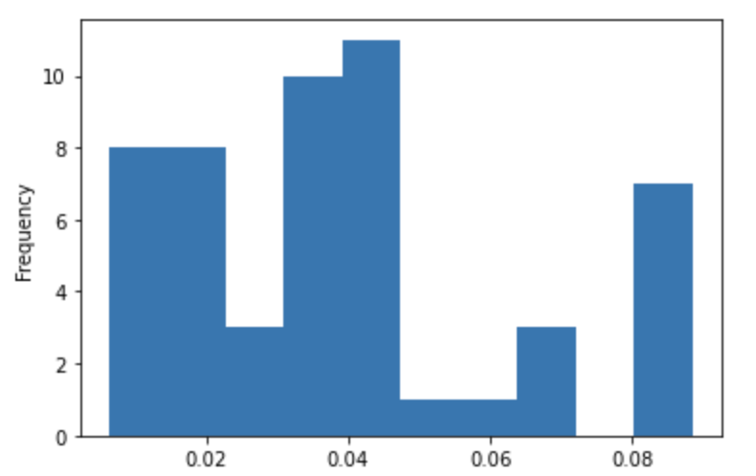
Calculate Euclidean Distance (a^2 + b^2 = c^2)
Distribution of Euclidean Distane

Slide 15
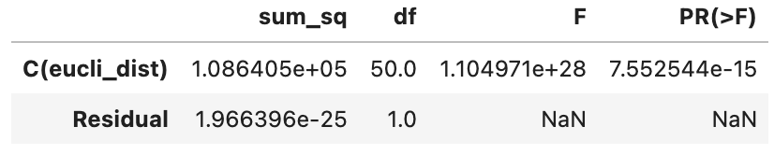
Test of ANOVA (Omit Expration sinece its out of scope)
P-value:
7.552544e-15

Slide 16
Conclution
Conclusion:
The Euclidean Distane is significant pridictor of the # of likes on the Fouresuqare web. (Significant level 0.95)
The hotelling’s Law is true on the real world expecially in the city of Manhattan

